Slide 1

MLB Wholesale and Correspondent – Pricing and Requesting Locks
How to view pricing and/or request a lock on the MLB Wholesale and Correspondent Portal

Slide 2
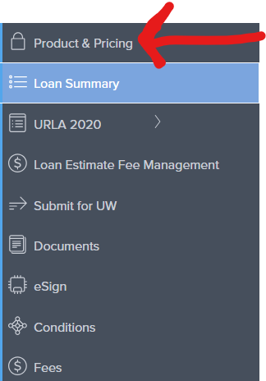
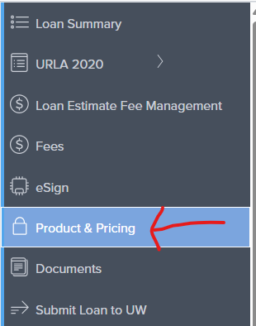
How to price / Request a lock on a loan
Once you log into your account at
www.MLBwholesale.com
and enter your file, go to
“Product & Pricing” tab on the
Left hand side of screen.
It will be located as the top choice for correspondent files and in the middle for wholesale files.

Slide 3
How to price / Request a lock on a loan
After you click “Product & Pricing”, the search form appears.
If you have a Wholesale file, make sure you select your comp also from the drop down (LPC or BPC). If LPC, also select the percentage of comp you want from the drop-down options.
If you have a Correspondent file, there is no drop down for comp as you are the lender and you control your own comp.
When ready, click “search” (on top right)
** See next slide for example of what this looks like on a Wholesale file**
** See slide after that for what this looks like on a Correspondent file**

Slide 4
FYI – For Pricing purposes only
FYI:
If you have an Agency (Fannie/Freddie) loan, rule of thumb, for pricing purposes only, make sure your DTI Ratio is < 50.
  Make reserve months 6 or more.
If you have an FHA loan, rule of thumb, for pricing purposes only, make sure your DTI Ratio is < 57
  If loan is a manual underwrite, make DTI Ratio is < 50
  Make reserve months 6 or more.
If you have a VA loan, make sure your DTI is <60
  If loan is a manual underwrite, make DTI Ratio is < 50
  Make reserve months 6 or more.
If you have a Non-QM loan, complete the reserves field accurately.
  Make Automated U/W System say “Not Specified”
  Make loan type “Non-Conforming”
  Make “Product Filters” only read “Expanded Guidelines”
  Fill in your “Income verification Type”, DSCR ratio, and Mortgage Lates.

Slide 5
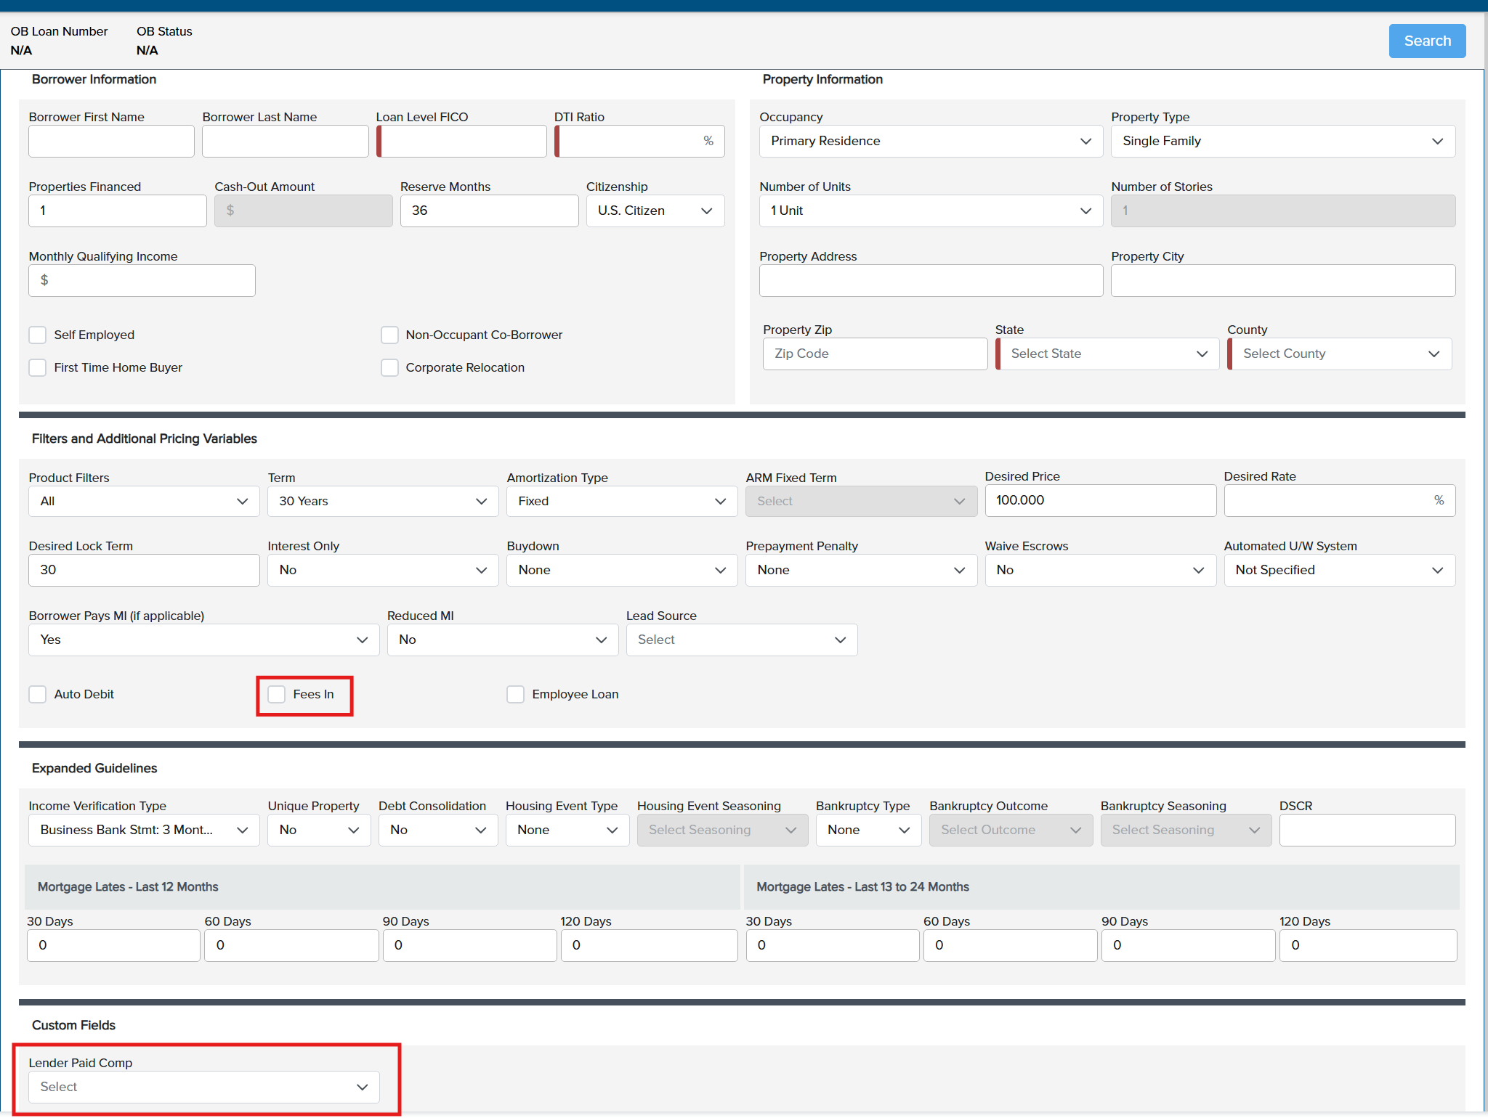
For Wholesale Files only – choose comp For your desired comp plan
Put a check mark in the “fees in” box if you want fees in. Leave blank if you want fees out

Slide 6
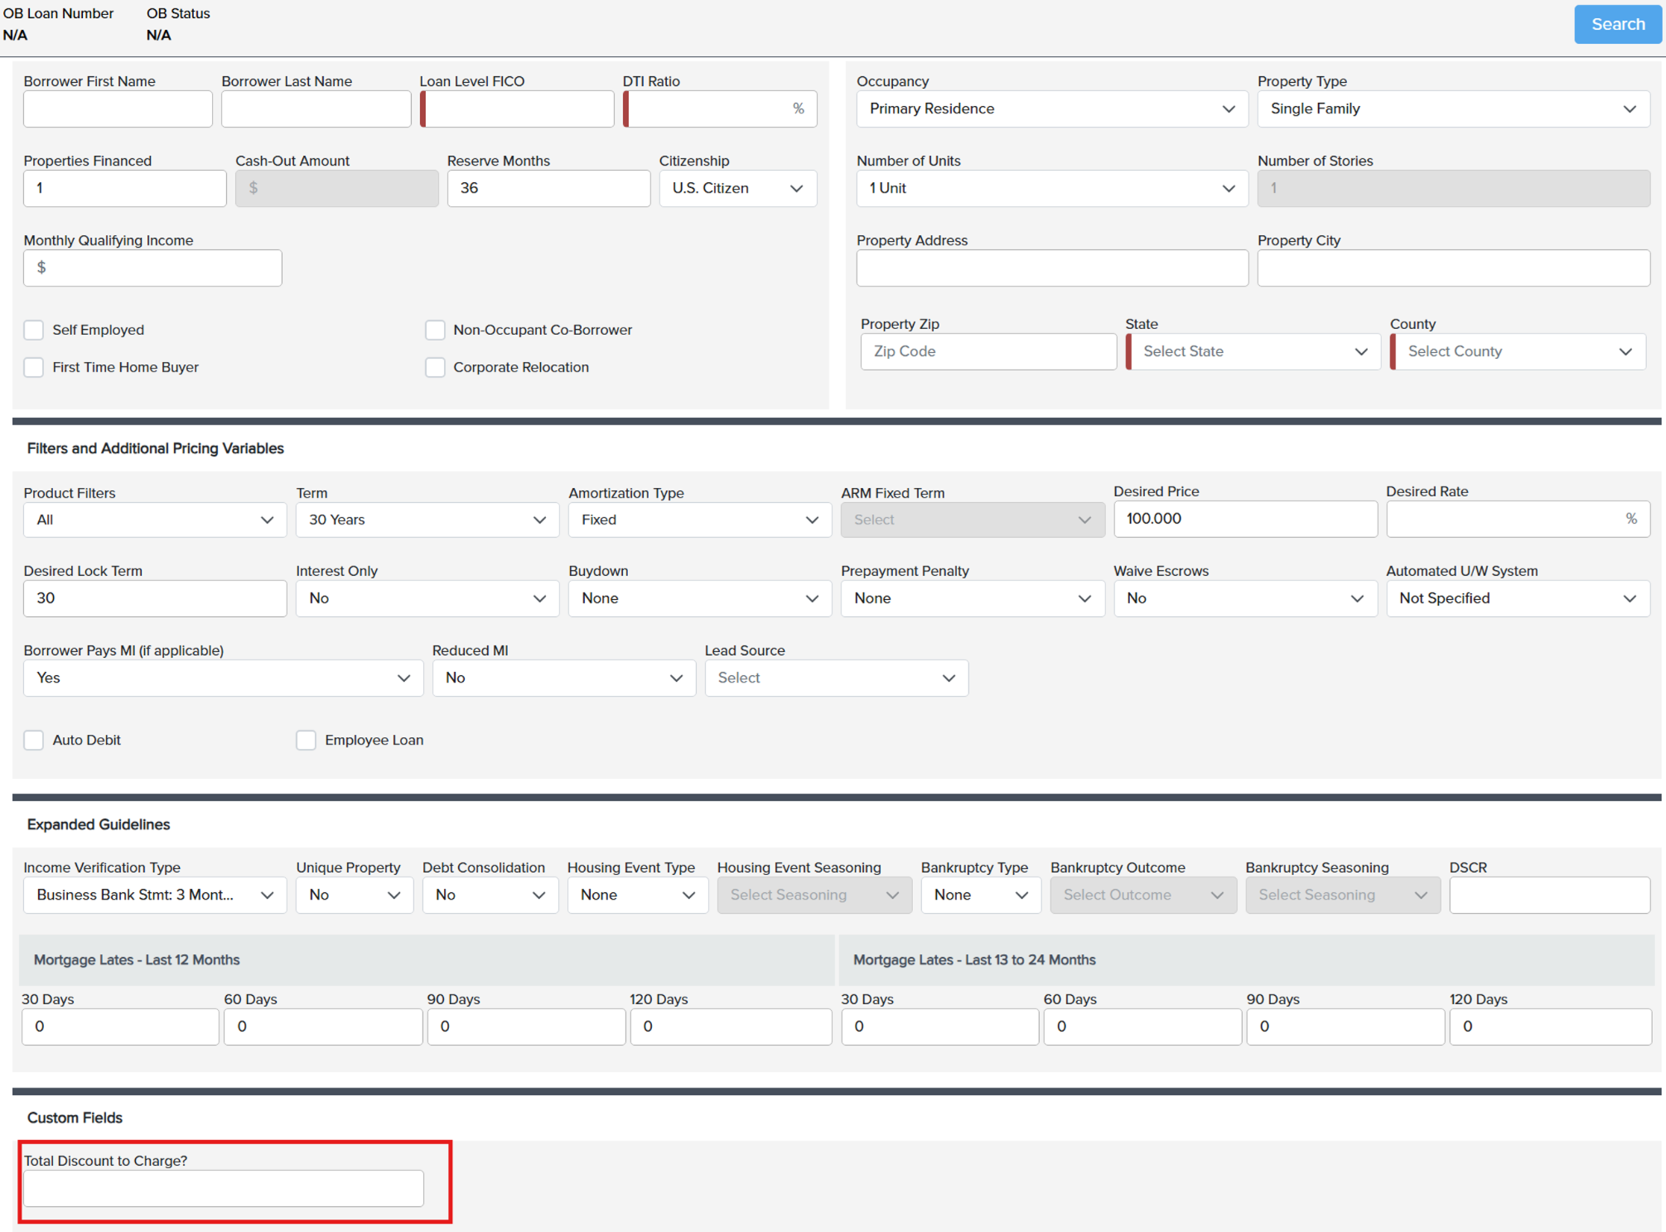
For Correspondent Files only –state how many discount points you want to charge

Slide 7
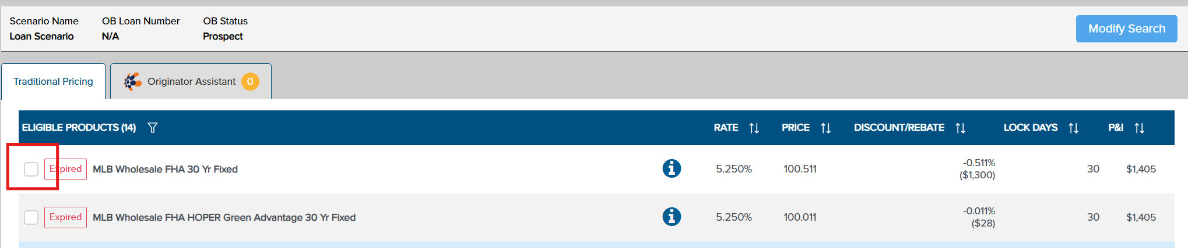
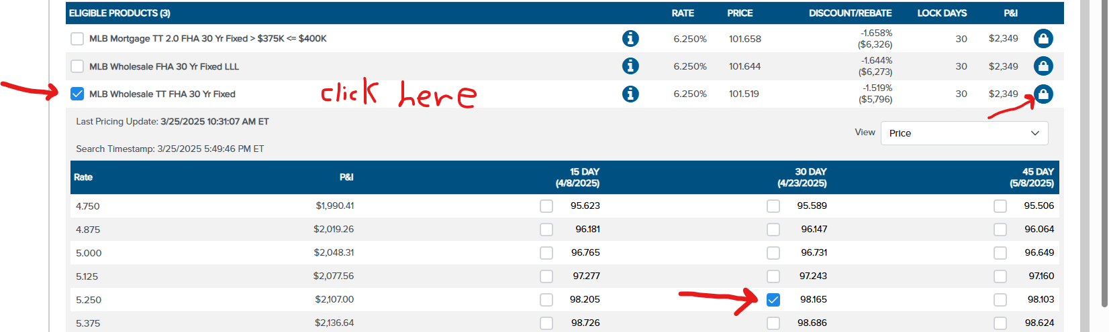
How to price / Request a lock on a loan
Types of pricing
– MLB Wholesale
- Conventional Fixed, MLB Plus (For Non-QM), and 203 K (for reno loans) check off here →
Eligible and ineligible products will show
Put a checkmark on the eligible pricing product you want
Click on the product. The rate stack will then show. Scroll down to see more rates.
Put a check mark on the rate/price you are going with
Click on the padlock on the right side of screen

Slide 8
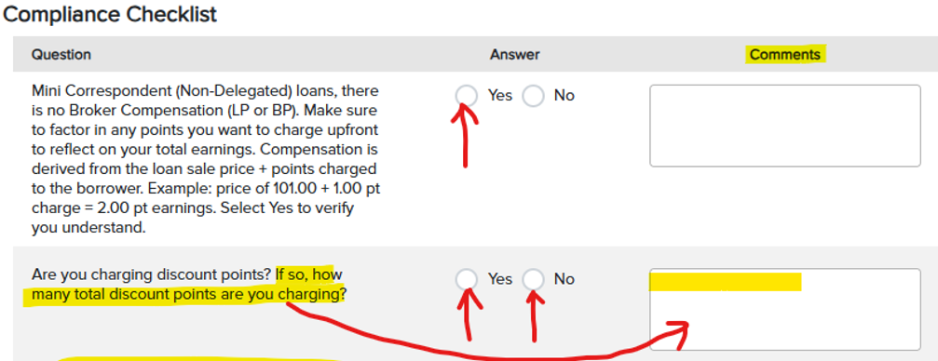
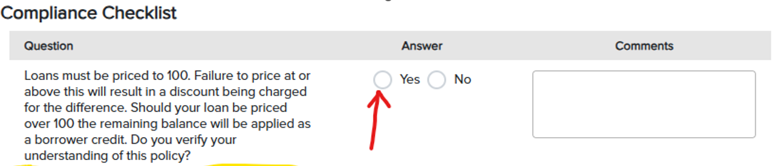
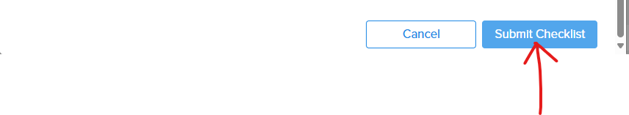
How to price / Request a lock on a loan
After you click the padlock, the Compliance Checklist will pop up.
Correspondent checklist example on the left. Please read the checklist. Fill in all the radio buttons.
Wholesale checklist example on the right. Please read the checklist. Fill in all the radio buttons.
Click “Submit Checklist” after you answer the questions and fill in the comments (if necessary).

Slide 9
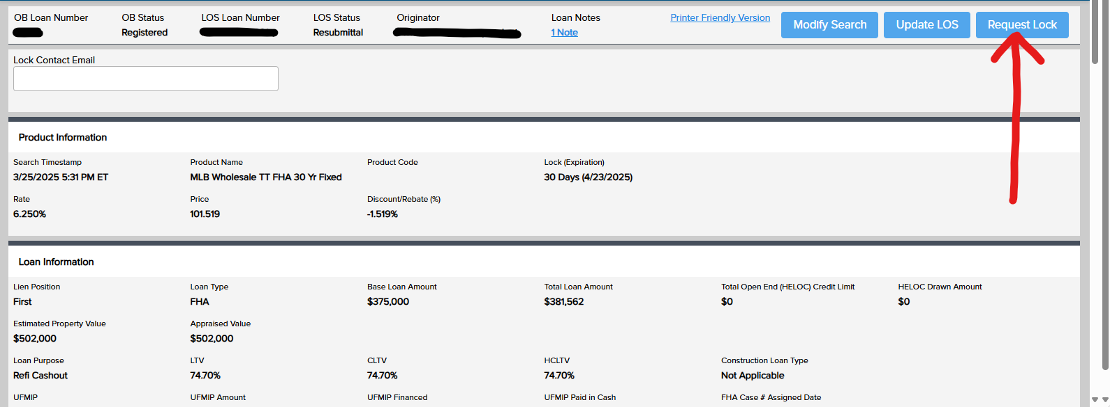
How to submit your lock request
Click the “Request Lock” button

Slide 10
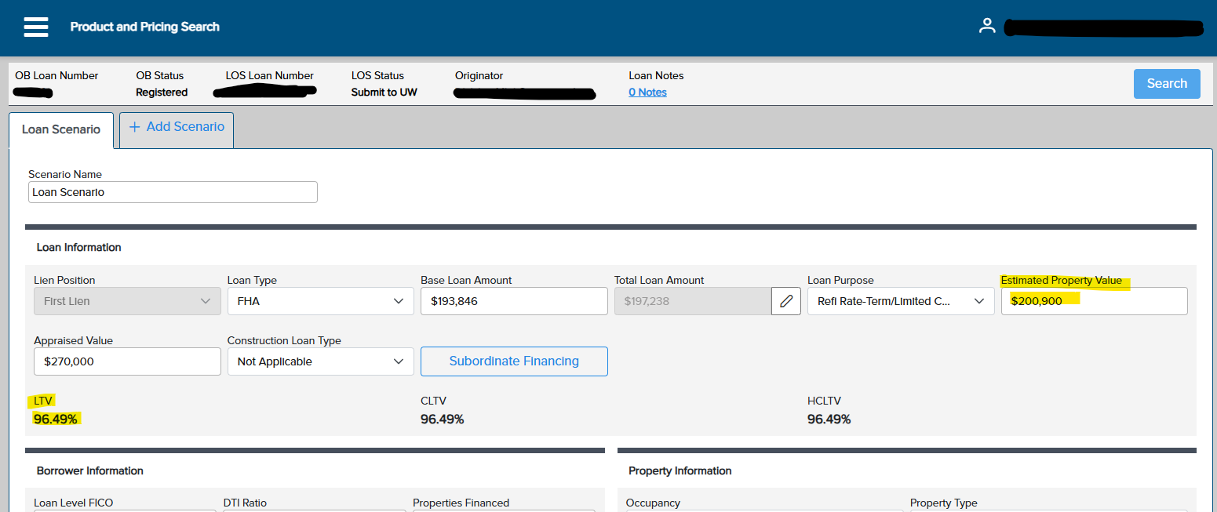
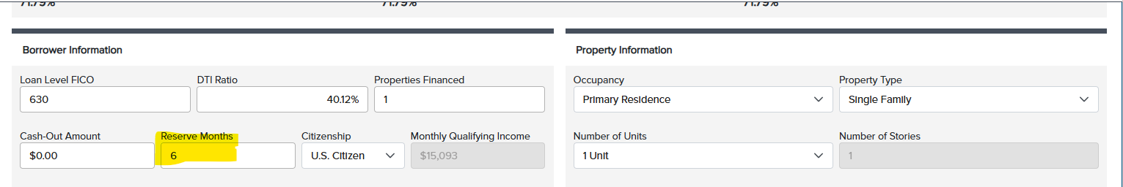
Frequently asked questions
How to request an FHA 203K Lock, a Conventional HomeStyle Lock, or a VA Reno Lock?
-Sometimes OB makes the LTV too high for pricing purposes (you might see for example 111 or 144); which will not allow you to price out a loan.
-Make the Estimated Property Value whatever you need to make it to make the LTV 96.5 (or very close to 96.5) for 203 K’s
-Make it whatever you need it to be to get a 95 LTV for Homestyle’s. This is just so you can get the lock request through.
-Make it whatever you need to get a 100 LTV for VA reno loans.
-We’ll put it back to what it should be after we’re done completing the lock request.
*Also, make the reserve months “6” in the search form just to get the lock request though.

Slide 11
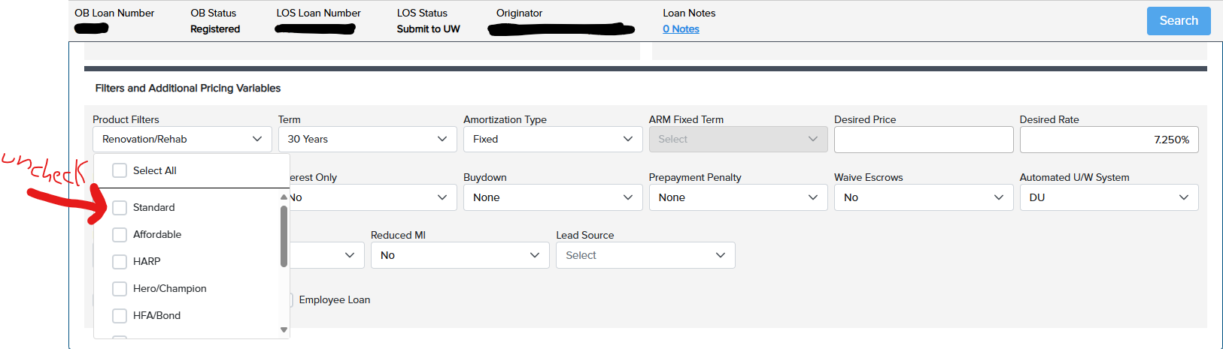
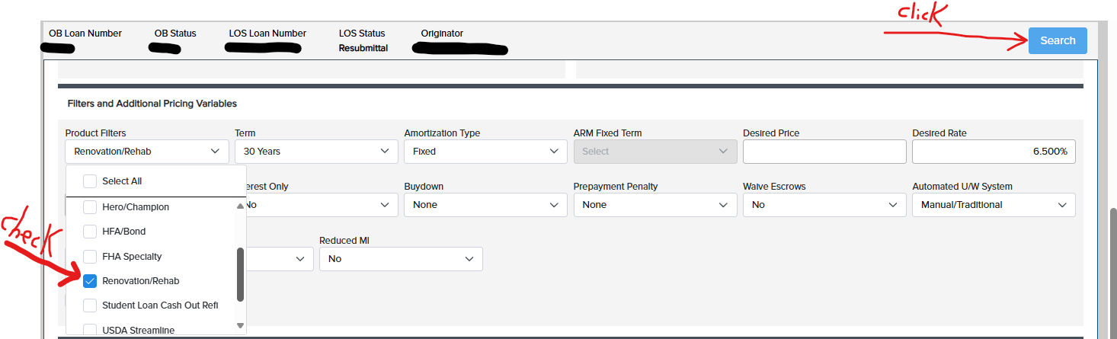
Frequently asked questions
or a VA Reno Lock?
Product Filters:
-Remove the check mark from “Standard”
-Make sure to put a check mark in the “Renovation/Rehab” box.
Click “Search”.
How to request an FHA 203K Lock or a Conventional Homestyle Lock? Continued …

Slide 12
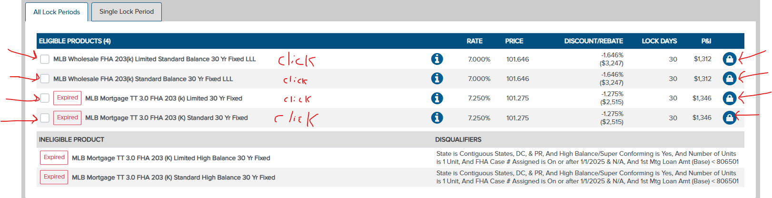
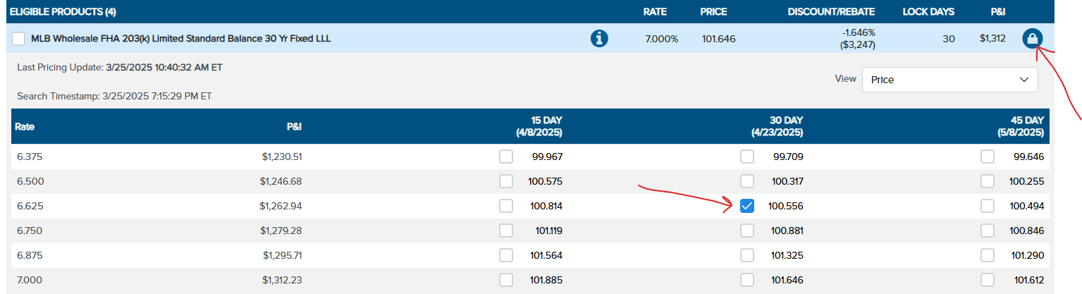
Frequently asked questions
or a VA Reno Lock?
-Click in the check box on the Limited product if you have a limited 203 K
-Click in the check box on the Standard product if you have a standard 203 K
-Click on the product itself to view the rate stack.
-Click on the rate/price you want
-Click on the padlock on the right side
How to request an FHA 203K Lock or Conventional Homestyle lock? Continued …

Slide 13
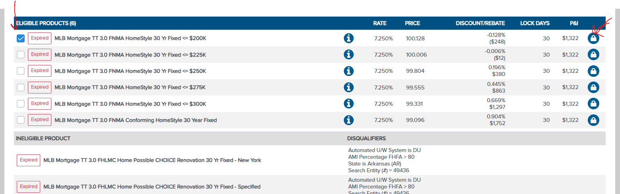
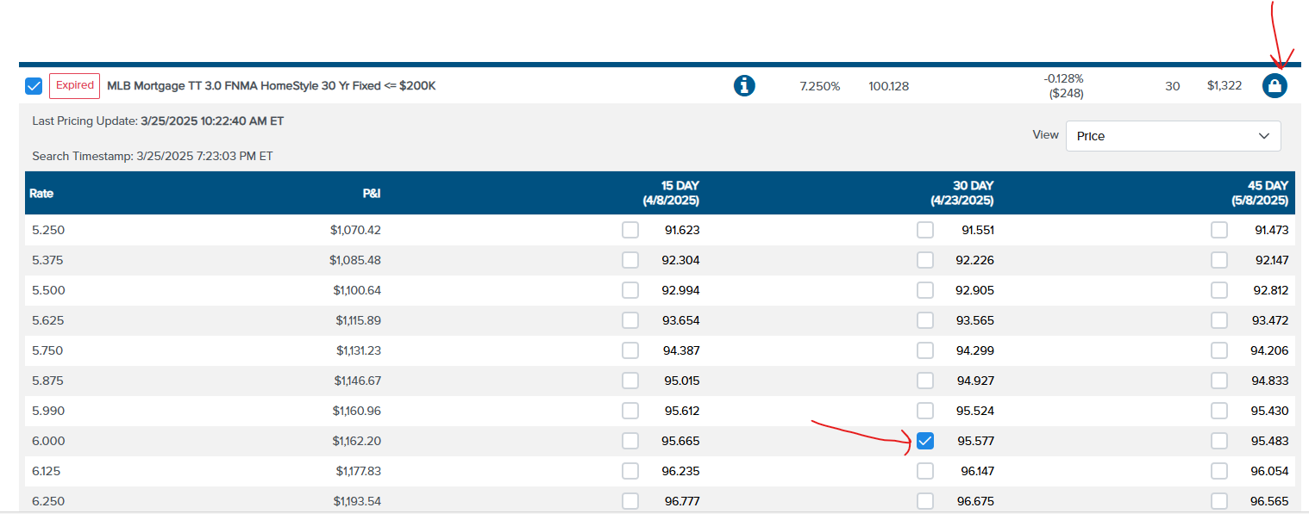
Frequently asked questions
The rest of the way follow the usual steps to request the lock !
(Meaning fill out the compliance checklist and then click the “request lock” button).
How to request an FHA 203K Lock, a Conventional Homestyle lock, or a VA Reno Lock? Continued …
Here is homestyle pricing
-Click on the product itself to view the rate stack.
-Click on the rate/price you want
-Click on the padlock on the right side

Slide 14
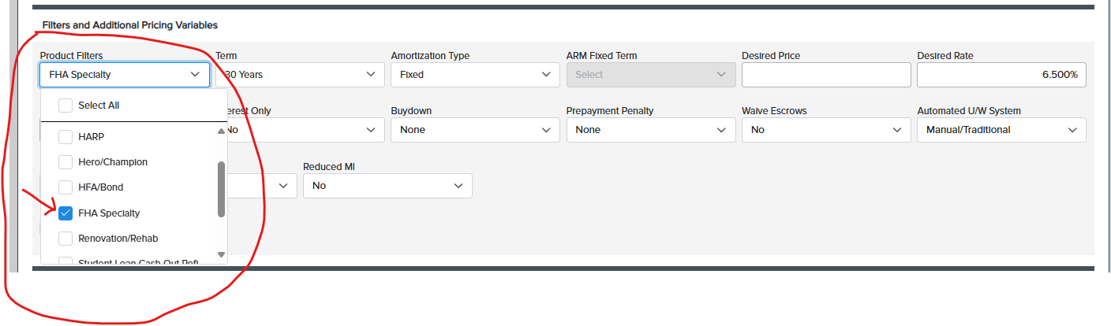
Frequently Asked questions
How to request an FHA 203 H Lock?
  Main thing to remember is make your product filters read “FHA Specialty”
  Make reserve months 6, then click “search”

Slide 15
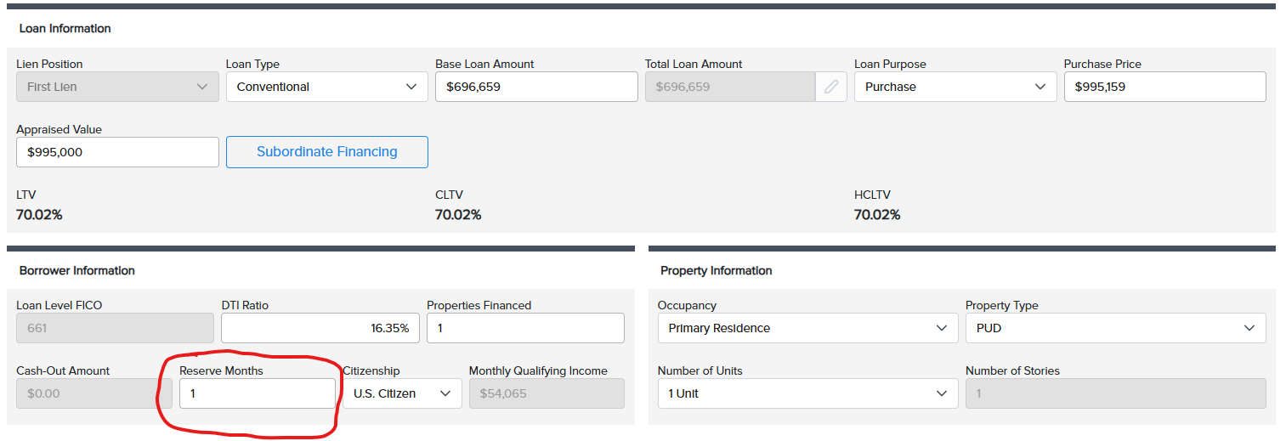
Pricing Guide to Non-QM in OB
To keep in mind:
NJ does not allow prepayment penalties unless you are a Corporation.
Reserve months – complete field accurately.
Interest only, prepayment penalty, Mortgage lates, income verification type, DSCR – those fields you need to fill out in OB.
Please note this is a generic tutorial. If you do not have a DSCR loan for example, you would not make that the income verification type and you would not have a DSCR ratio you need to fill in.
To price this out properly in OB, make sure you know the following so you can price it out correctly:
-What type of Non-QM?
-Is there a DSCR?
-Is it P&L?
-Is it business bank statement, personal bank statement?
-Is it interest only?
-Is there a Pre-payment Penalty?

Slide 16
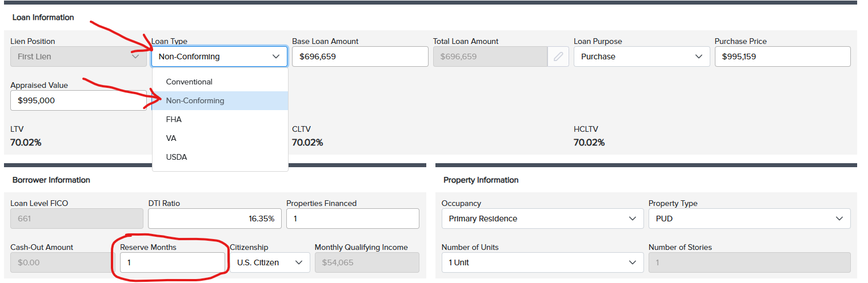
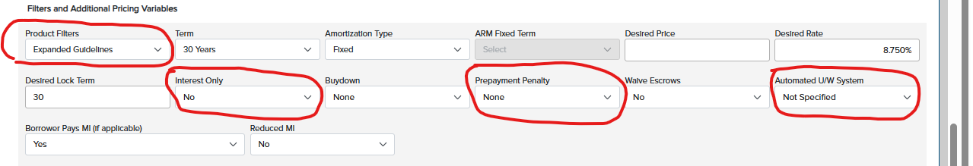
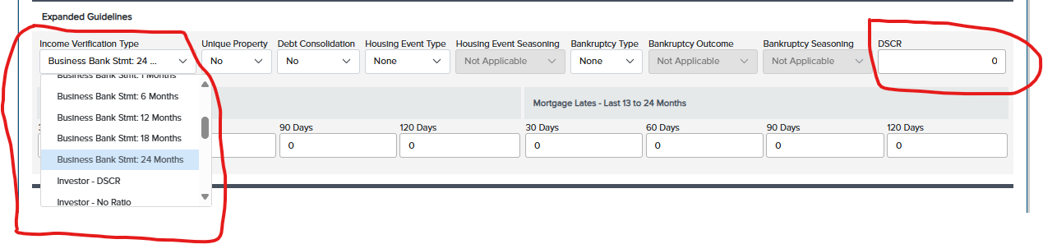
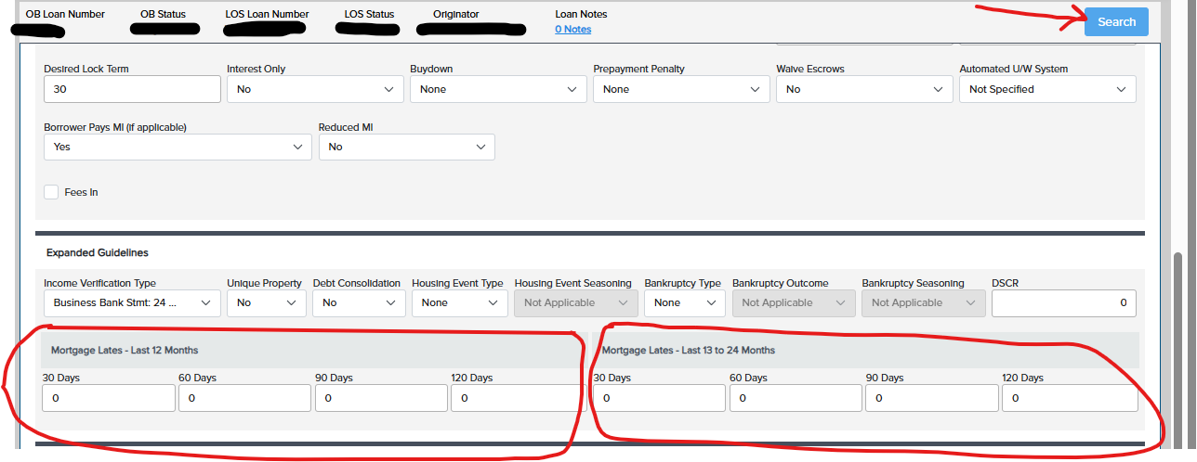
Pricing Guide to Non-QM in OB
-
-Loan type, select “Non-Conforming”
-Reserve months – complete field accurately.
-Make Product filters “Expanded Guidelines”
-If you are going Interest only, please select yes or no.
-If you are doing a pre-payment penalty, please select it from the dropdown.
**Make the Automated U/W System drop down say “Not Specified”. **
-Choose your Income Verification Type
-If you have a DSCR loan, fill in the ratio. If not a DSCR loan, leave it blank.
-Fill in any mortgage lates.
-Click submit and then you will see the eligible products.

Slide 17
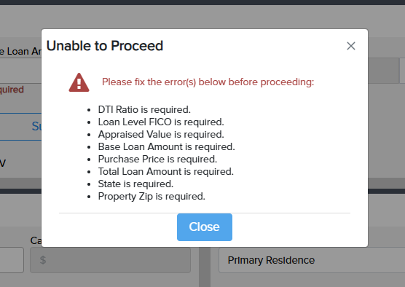
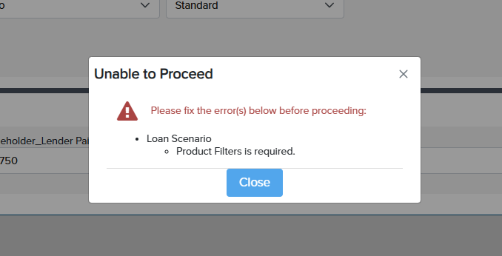
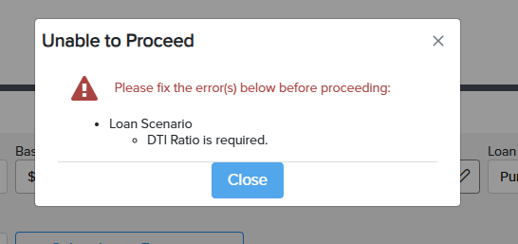
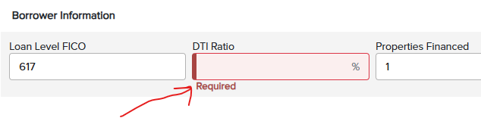
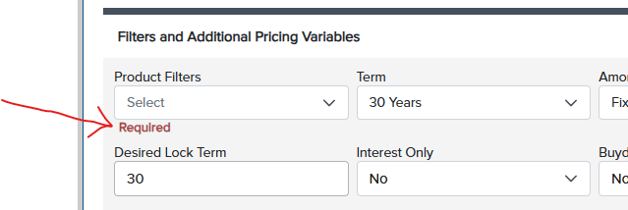
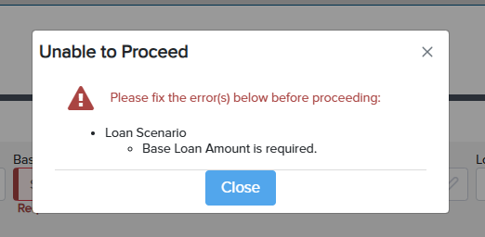

Frequently asked questions
Possible errors on the search form:

Slide 18
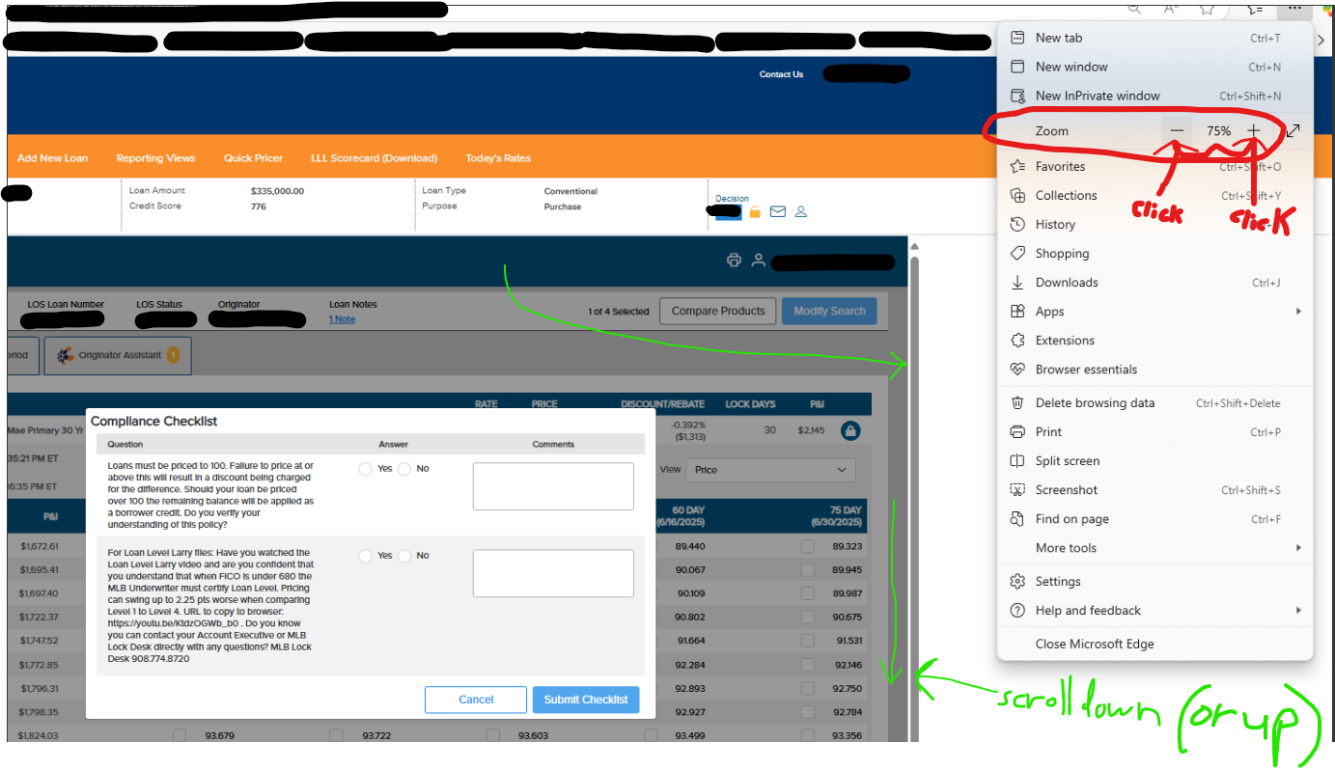
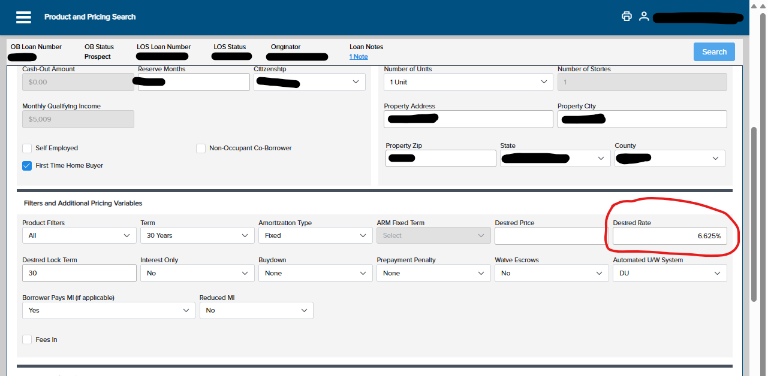
FYI – IF you cannot see something on your Screen Due to your browser
If you are not able to see all the rates or select the rate you want, please use the vertical scroll bar to scroll down or up (see snippet on right).
You can also search for a specific rate by typing in the rate you want in the “Desired Rate” box (see snippet on left).
Same on the compliance checklist - If you are not able to see the “Submit Checklist” button, please use the vertical scroll bar to scroll down or up. You can also zoom in or out (see snippets on right and left).
You can also zoom out if you are not able to see what you need to see.

Slide 19
FYI from our Lock Desk
Locks can be extended for upwards of 30 days before the need to be relocked
3-day extension is .065, 7-day extension is .125, 14-day extension is .25, and 30-day extension is .50
Remember, when you lock, you are locked into the base price. Your level can change, but your base price will never change (unless expired or requires an extension)
The Desk opens at 10:30 AM ET and closes at 11pm ET
For all comments, questions or help please reach out to the desk at loanlock@mlbmortgage.com or call 732-243-0140

